Slide 1

Manufacturing Downtime Analysis Report

Slide 2
Team Members
Nada Helmy Ahmed
Eman Ahmed Hosni
Shireen Fikry Shoukry
Mina Leon Fahmy
Amr Gamal Abdelhady
Zakaria Fathy

Slide 3
Presentation Roadmap
Our project roadmap details manufacturing downtime analysis for improved efficiency.
01
05
Introduction
DAX Calculations
Understand project purpose: address downtime and enhance operational efficiency.
Creating custom calculations for KPIS and measures to uncover business insights for decision making
02
06
Data Resources
Data Modelling
Introduce Data Resources used.
Design a data model for robust downtime analysis and production efficiency insights.
03
07
Data Preparation (Cleaning)
Simple Visuals
Procedures followed to clean the data to improve its quality, consistency, and reliability
for analysis and decision-making
Power BI visuals used to turn data into interactive visuals
04
08
Data Modeling
Dynamic Dashboard
Structuring and connecting tables of data to create a logical, usable foundation for
reports and analysis.
Gathering all into an interactive reports that provide real time, User-tailored insights , updated based on user interactions.

Slide 4

1- Introduction: Addressing Project Goal
In today's competitive industrial landscape, effective management of equipment failures and production halts is paramount for sustained success.
Our project is driven by the critical need to minimize manufacturing downtime, which significantly impacts production efficiency, operational costs, and delivery schedules.
This project aims to establish a framework for analyzing and reducing manufacturing downtime, leveraging industrial data to identify root causes, predict potential failures, and optimize overall equipment effectiveness (OEE).

Slide 5
2- Data Resources: Foundation of Our Analysis
Our analysis is built upon comprehensive historical data from DEPI, provided in Excel spreadsheets.
This dataset has four tables that contain detailed information on line productivity, products, downtime factors, and line downtime, enabling a thorough and structured approach to predictive analytics.

Slide 6
3- Data Preparation (Cleaning)
We use Power Query to transform, clean, and reshape raw data into a usable format for analysis and visualization
Techniques
Check Index Columns (Primary key are unique) – No duplicates found
Trim white Space
Remove Blank Columns
Standardize Data Formats
Unpivot columns

Slide 7
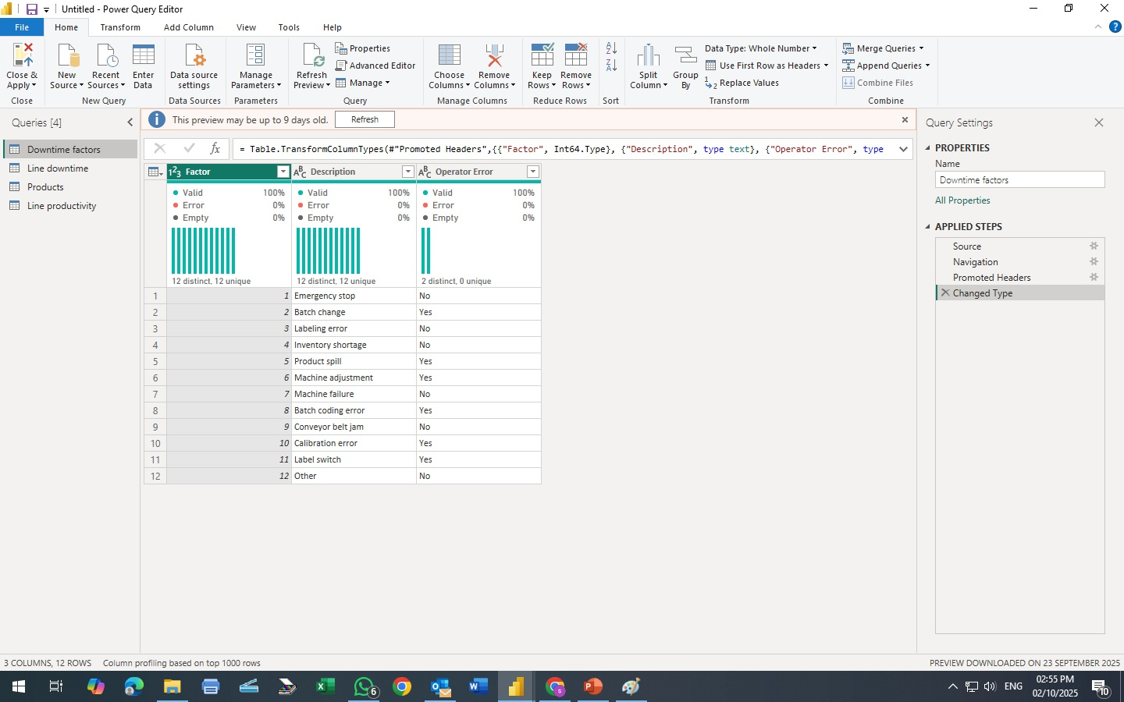
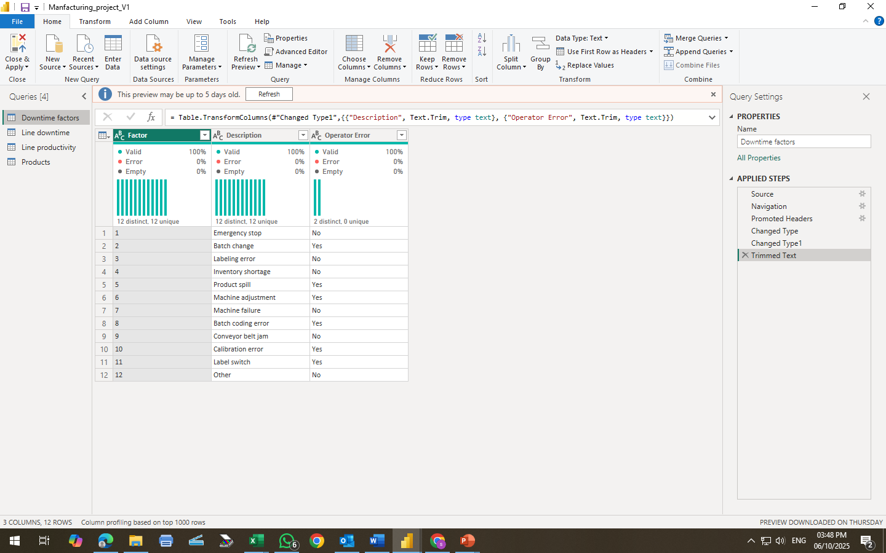
Downtime Factors Table
Unique Distinct Values for the Primary Key
Before
After
Trim White Space
Detect Data type

Slide 8
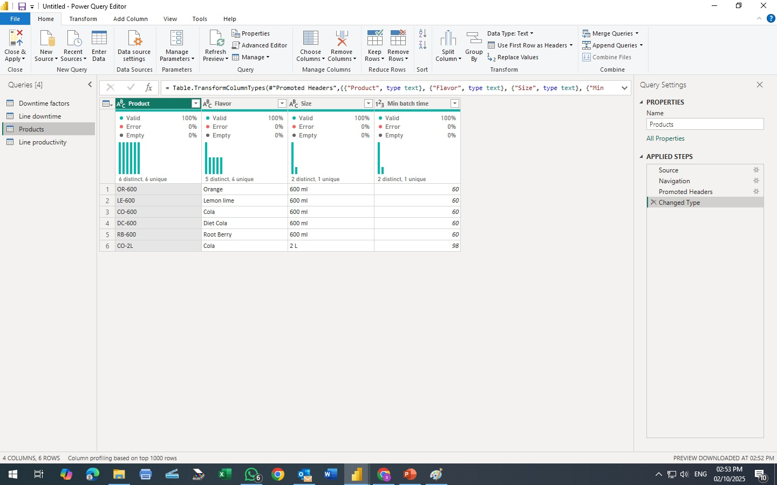
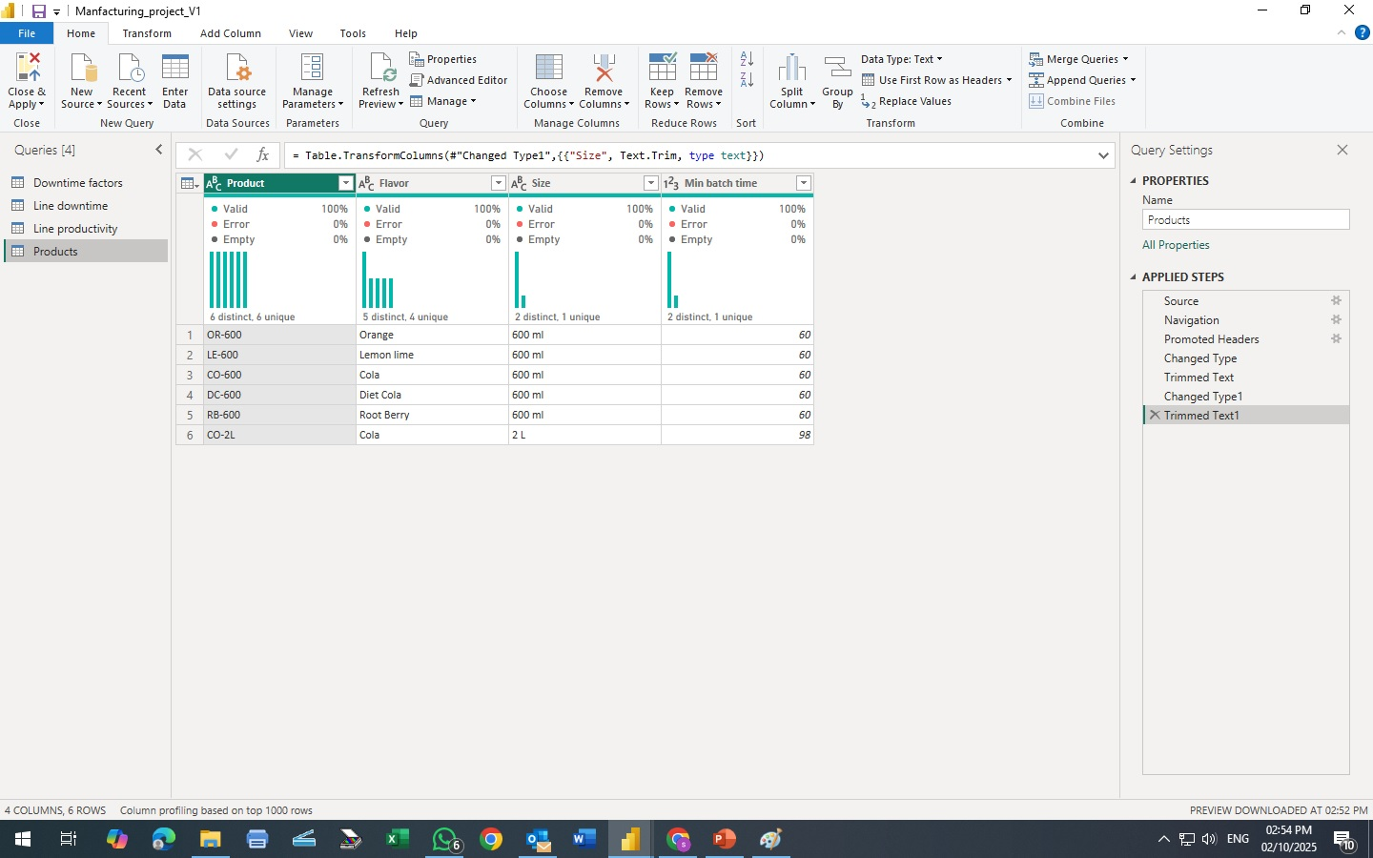
Products Table
Before
After
Unique Distinct Values for the Primary Key
Trim White Space
Detect Data type

Slide 9
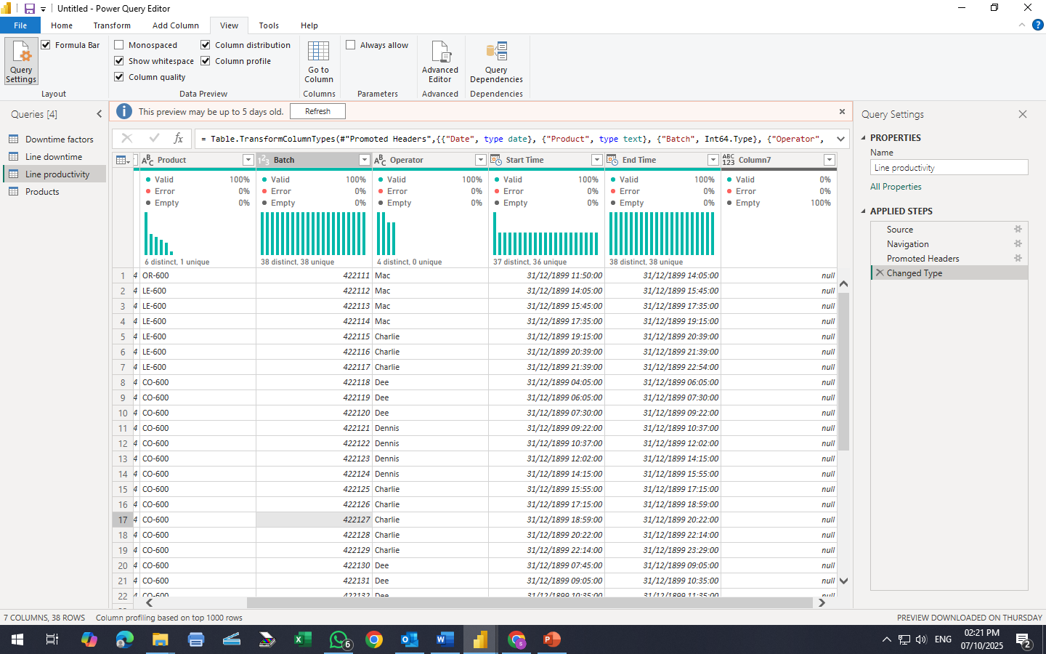
Line Productivity Table
In correct data type for Start time and End time
Before
Empty Column

Slide 10
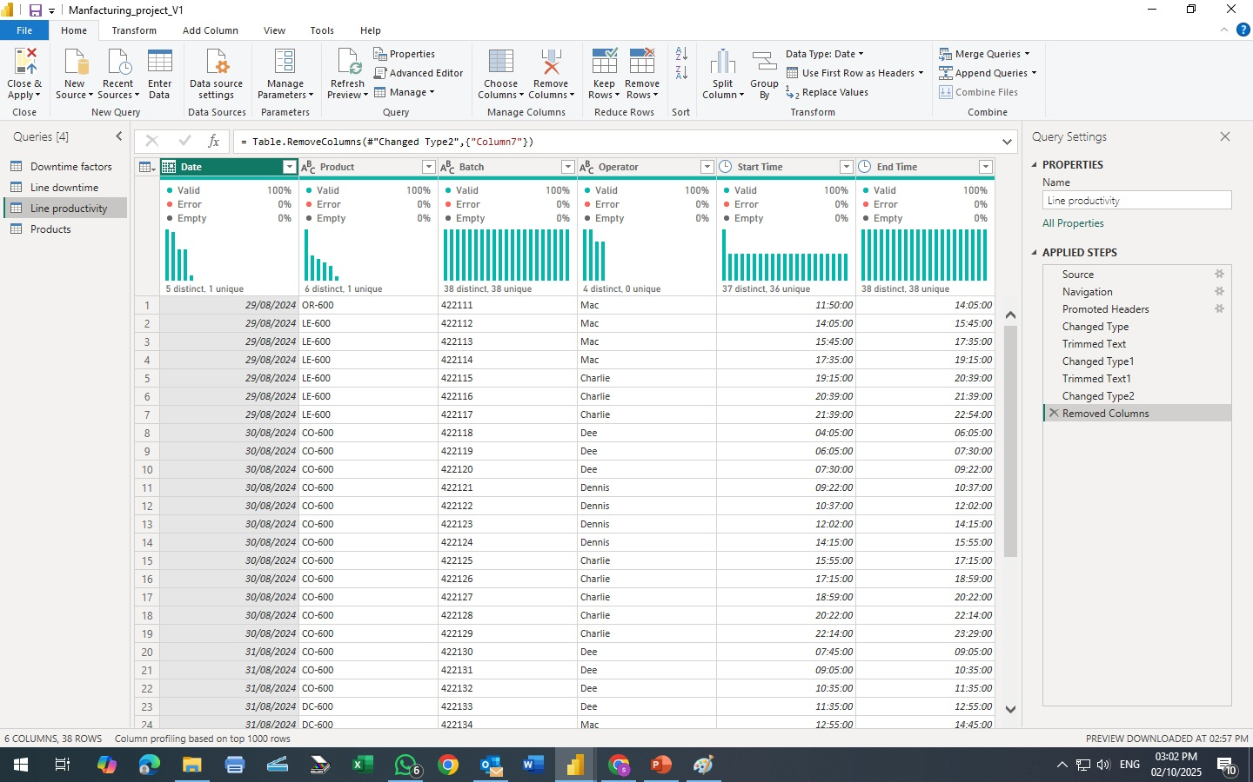
Line Productivity Table
Correct data type for Start time and End time
Time I/O Date
After
Unique Distinct Values for the Primary Key
Remove Empty Column
Trim White Space
Detect Data type

Slide 11
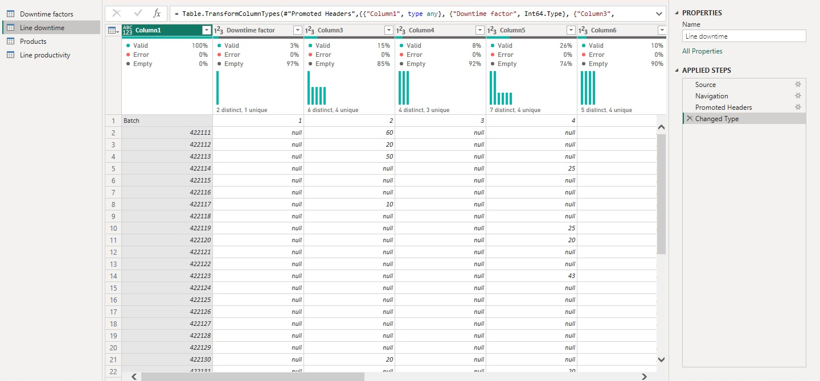
Line Downtime Table
Incorrect headers
Before
Null Values

Slide 12
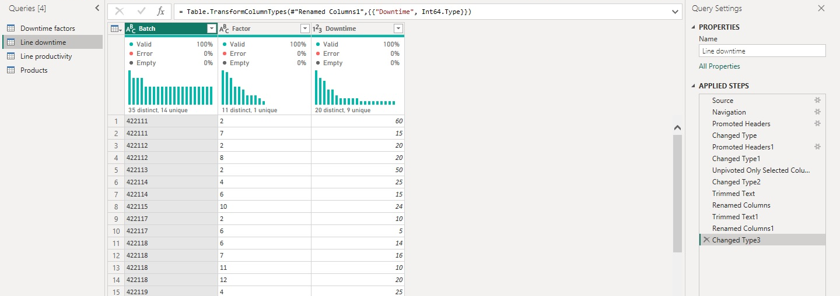
Line Downtime Table
Set first row as header
Use Unpivot columns
To put all similar Values in one column
Then rename attribute & Values columns to Factor and downtime respectively
After
After

Slide 13
4- Data Modelling
Fact table and Dimension tables, are connected by Snowflake Schema
Line Productivity and Downtime factor (Dimension tables ) are connected to Line Downtime table (Fact Table)
Through 1:many relation
The two Dimension Tables: Products & Line Productivity are connected together through a 1: many relation

Slide 14
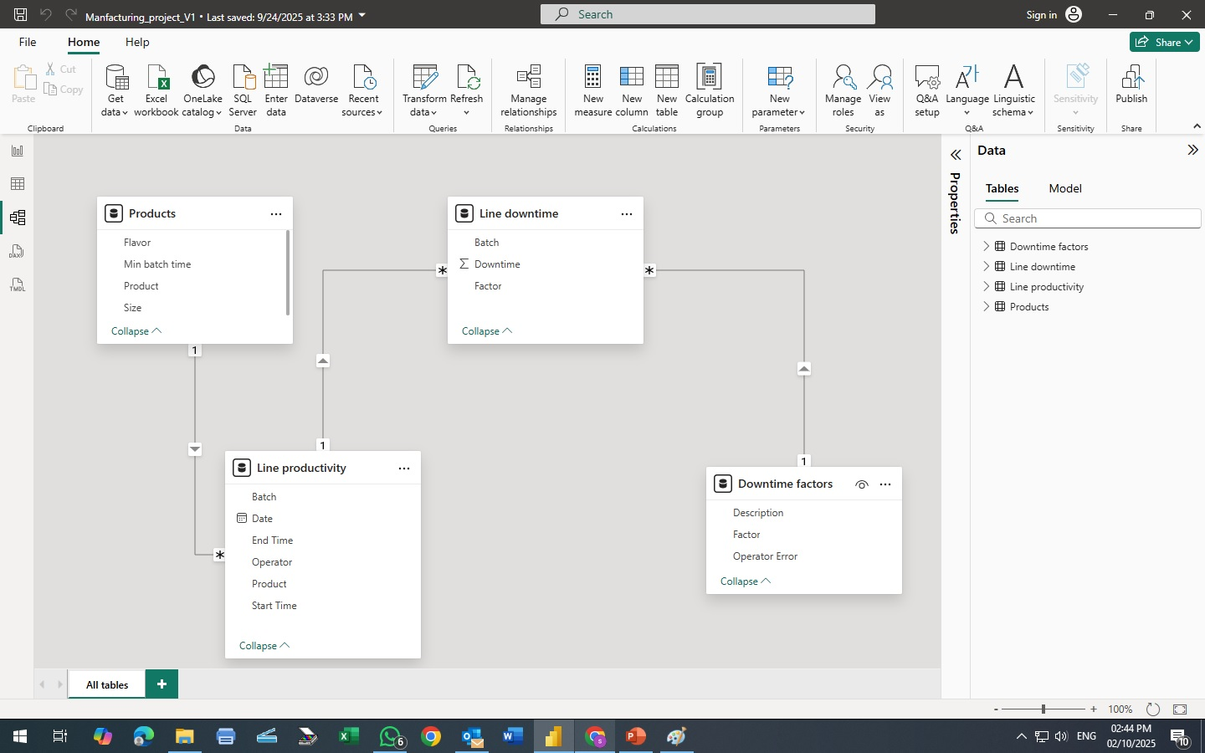
4- Data Modelling

